Slide 1
Chapter 9-3
Dynamic Routing Protocols

Slide 2
Observations
In section 9-2, the concept of configuring a network using a static routing protocol was presented. It became obvious that the time required for entering and maintaining the routes was a problem.
Hence, the reason a static routing protocol is of limited use in campus type networks. However, static routes are used in situations such as configuring small networks with few routes.

Slide 3
Dynamic Routing Protocols
This section introduces an improvement over static routing through the use of dynamic routing protocols.
Dynamic routing protocols enable the router’s routing tables to be dynamically updated to account for loss or changes in routes or changes in data traffic.
The routers update their routing tables using information obtained from adjacent routers. The routing protocol is responsible for managing the exchange of routing information between the routers and the choice of routing protocol defines how the routing information is exchanged and used.

Slide 4
Table 9-2 Features of dynamic routing protocols
Feature
What information is exchanged between routers.
When is updated routing information is exchanged.
What are the steps for reacting to changes in the network.
Establish a criteria for establishing the best route selection.

Slide 5
Four Key Issues with Dynamic Routing Protocols
1. Path determination
  A procedure in the protocol that is used to determine the best route.
2. Metric
  measure assigned to routes for ranking the routes best to worst, the smaller the number, the better.
3. Convergence
  This happens when a router obtains a clear view of the routes in a network. The time it takes for the router to obtain a clear view is called the convergence time.
4. Load balancing
  A procedure in the protocol that enables routers to use any of the multiple data paths available from multiple routers to reach the destination.

Slide 6
Examples of Route Metrics
hop count – the number of routers the data packet must pass through to reach the destination network
reliability – a measure of the reliability of the link typically in terms of the amount of errors
bandwidth – having to do with the data capacity of the networking link, a fast Ethernet 100 Mbps link has greater data capacity than a 10 Mbps Ethernet link.
delay – the time it takes for a data packet to travel from a source to destination
cost – this is a value typically assigned by the network administrator that takes into account bandwidth and expense.
load - having to do with the network activity on a link or router.
ticks - the measured delay time in terms of clock ticks where each tick is approximately 55 milliseconds.

Slide 7
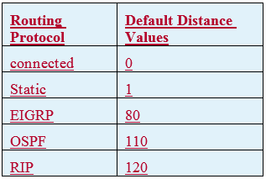
Route Metrics
Another concept related to metrics is administrative distance.
Administrative distance is a feature used by routing protocols to select the best path when more than one path is available.
For example, let’s assume there are two
network routes. One is an OSPF route
and the other is EIGRP. The OSPF route
has an administrative distance of 110 while
EIGRP has an administrative distance of 90.
The EIGRP route will be selected as the
preferred route.

Slide 8
Dynamic Routing Protocols
There are two types of dynamic routing protocols; Distance Vector and Link-state routing protocols.
These protocols are briefly introduced in this section. The procedure for configuring a router using the RIP v2 dynamic routing protocol is examined in section 9-7.

Slide 9
distance vector protocol
a routing algorithm that periodically sends the entire routing table to its neighboring or adjacent router
When the neighboring router receives the routing table, it assigns a distance-vector number to each route. The distance-vector number is typically specified by some metric such as hop-count which is the number of routers the data must pass through to reach the destination network.

Slide 10
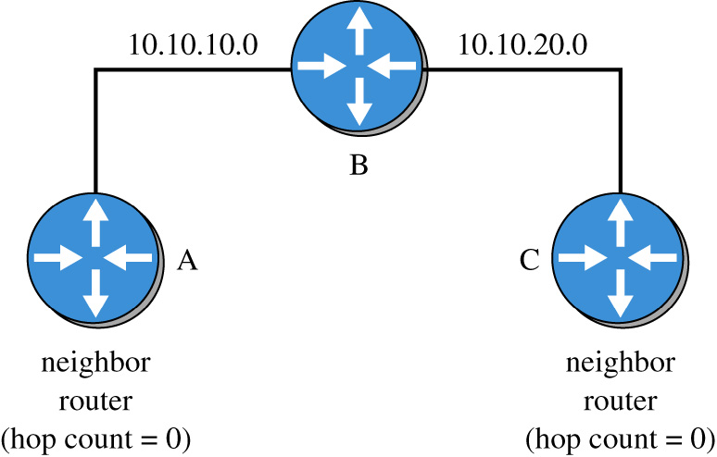
In a distance vector protocol, the router first determines its neighbors or adjacent routers. All of the interconnecting routes will have a distance or hop count of 0 An example is shown. Routers use the hop count metric to determine the best route to forward a data packet.

Slide 11
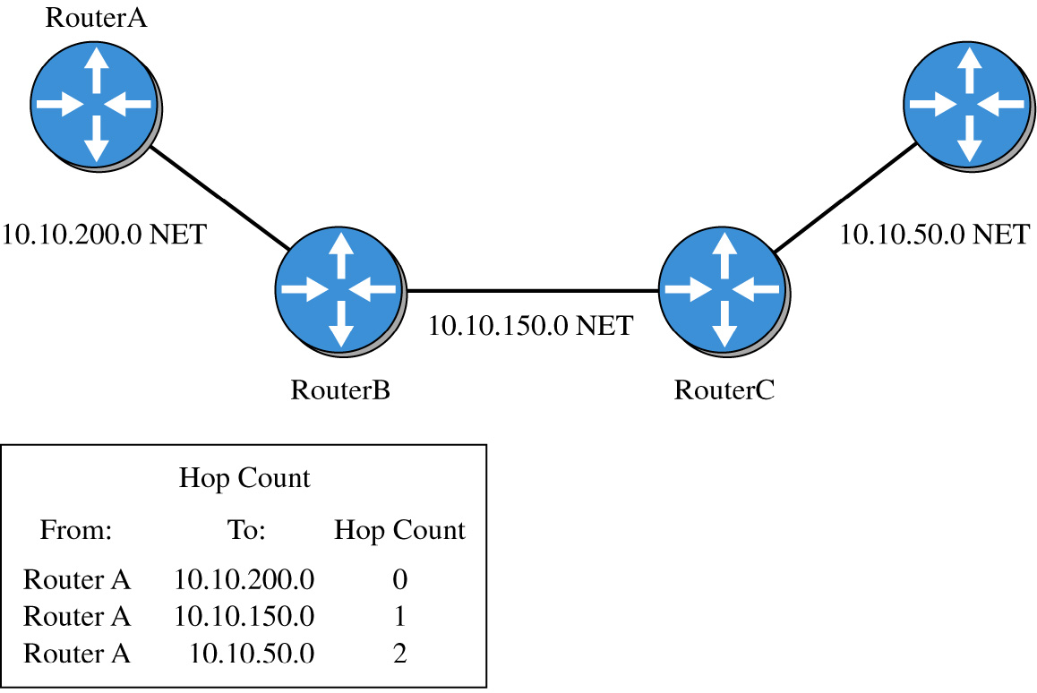
An example of determining the hop count to a destination subnet is provided. The hop count from Router A to the 10.10.200.0, 10.10.150.0, and 10.10.50.0 subnets are:
From: To: hop count
Router A 10.10.200.0 0
Router A 10.10.150.0 1
Router A 10.10.50.0 2

Slide 12
Distance Vector Protocols
In a distance vector protocol, each router determines its neighbors, builds its list of neighboring routers, and sends its routing table to its neighbors.
The neighbor routers update their routing table based on the received information.
When complete, each router’s routing table provides a list of known routes within the network.

Slide 13
Link State Protocols
Link State Routing Protocols establishes a relationship with a neighbor router. The routers exchange link state advertisements to update neighbors regarding route status.
The link state advertisements (LSAs) are only sent if there is a change or loss in the network routes and the link state protocols converge to route selection quickly.
This is a distinct advantage over distance-vector protocols that exchange updated routing tables at fixed time intervals and are slow to converge. In fact, link state routing protocols are replacing distance vector protocols.

Slide 14
Chapter 9-3 Key Terms
Dynamic Routing Protocols
Path Determination
Metric
Convergence
Load Balancing
Hop Count

Slide 15
Chapter 9-3 Key Terms
Reliability
Bandwidth
Delay
Cost
Load
Ticks
Distance Vector Protocol

